Slide 1

Cloud Security and Compliance Essentials
Introduction to Cloud Computing

Slide 2
Lecture Objectives
Understand the role of Azure Security Center in cloud security.
Learn about Key Vault, Azure Sentinel, and Azure Dedicated Hosts.
Explore security alerts, policy compliance, and secure score in cloud environments.
Perform Lab-3: Configuring basic security features in the cloud.

Slide 3

Introduction to Cloud Security
Why Cloud Security is Critical?
Protects sensitive data and applications.
Prevents unauthorized access and breaches.
Ensures compliance with industry regulations.
Key Cloud Security Challenges
Data breaches and insider threats.
Compliance and governance complexities.
Secure access control and identity management.

Slide 4
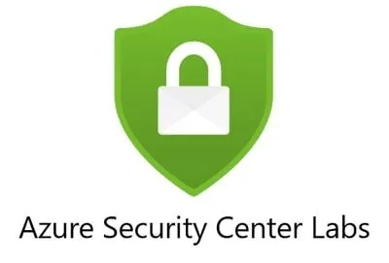
Azure Security Center Overview
Definition: A unified security management system for detecting and preventing threats.
Key Features:
Threat protection: Detects and mitigates threats across workloads.
Security recommendations: Prioritizes actions for security improvement.
Secure score: Measures security posture and provides improvement guidance.
Compliance monitoring: Ensures cloud resources meet industry standards.

Slide 5
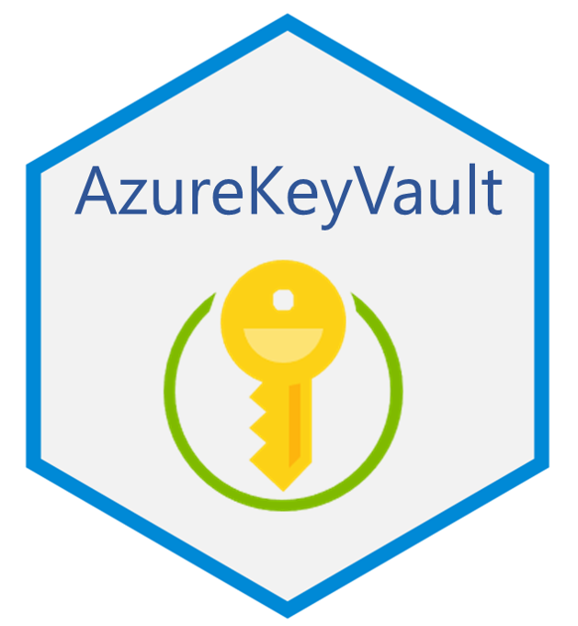
Azure Key Vault
Definition: Securely stores and manages cryptographic keys, secrets, and certificates.
Use Cases:
Protects encryption keys and passwords.
Controls access with Role-Based Access Control (RBAC).
Enables automated key rotation for security compliance.

Slide 6

Azure Sentinel (SIEM Solution)
Definition: A cloud-native Security Information and Event Management (SIEM) and Security Orchestration Automated Response (SOAR) solution.
Capabilities:
Collects and analyzes security data from multiple sources.
Uses AI and automation for real-time threat detection.
Investigates security incidents across cloud workloads.

Slide 7

Azure Dedicated Hosts
Definition: Provides physical server isolation for compliance and security.
Key Benefits:
Full hardware isolation for compliance-sensitive applications.
Helps meet regulatory and licensing requirements.
Provides greater control over server configurations.

Slide 8

Security Alerts and Threat Intelligence
What Are Security Alerts?
Automated notifications for potential security threats.
Helps detect suspicious activities and vulnerabilities.
Azure Threat Intelligence Features:
Integrates with Microsoft Defender for Cloud.
Uses AI-based security analytics for early detection.
Provides insights on attack trends and security risks.

Slide 9
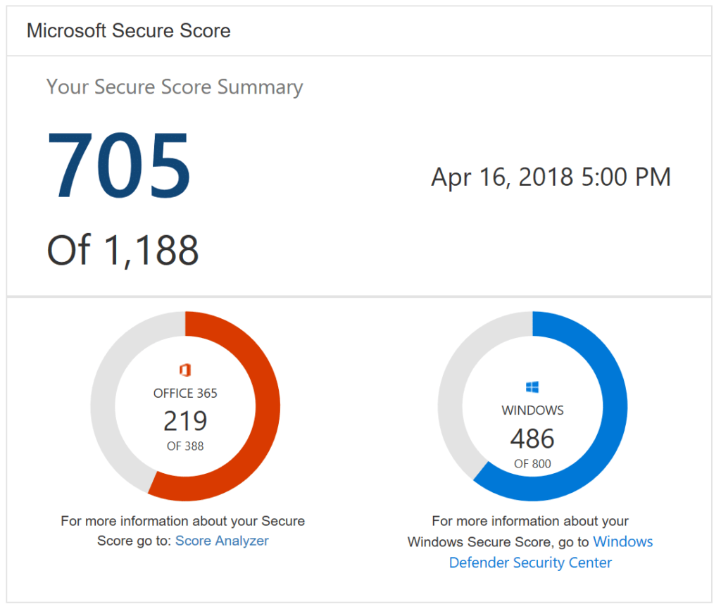
Policy Compliance and Secure Score
What is Policy Compliance?
Ensures cloud workloads adhere to security standards.
Helps organizations enforce security policies (e.g., ISO, NIST, GDPR).
Understanding Secure Score:
Score-based security evaluation of cloud resources.
Provides recommendations to improve security posture.
A higher score means better security resilience.

Slide 10
Lab-3 - Configuring Basic Security Features
Activity: Hands-on Security Setup (Using Free or Low-Cost Azure Features)
✅ Enable Microsoft Defender for Cloud (Free Tier)
Review security recommendations (without advanced threat protection).
Identify misconfigurations and vulnerabilities.
✅ Deploy and Manage Azure Key Vault (Free Tier)
Store a secret (e.g., database password).
Configure access control policies for secure access.

Slide 11
Lab-3 - Configuring Basic Security Features
✅ Configure Azure Storage Security (Free Tier)
Enable firewall and network protection for storage accounts.
Enable encryption at rest for stored data.
✅ Analyze Secure Score in Microsoft Defender for Cloud
Check current security posture based on recommendations.
Implement at least one security improvement (e.g., enabling MFA, restricting access).
Assessment: Lab-3 (1.5%)
Students must submit a summary report of actions taken.
Screenshots of configured security settings as proof of implementation.

Slide 12
Summary
Azure Security Center enhances threat detection and security monitoring.
Key Vault provides encrypted storage for keys and secrets.
Azure Sentinel is an AI-driven SIEM for security analytics.
Azure Dedicated Hosts offer physical isolation for security compliance.
Policy compliance and secure score help organizations strengthen security.

Slide 13
Questions?

